Slide 1
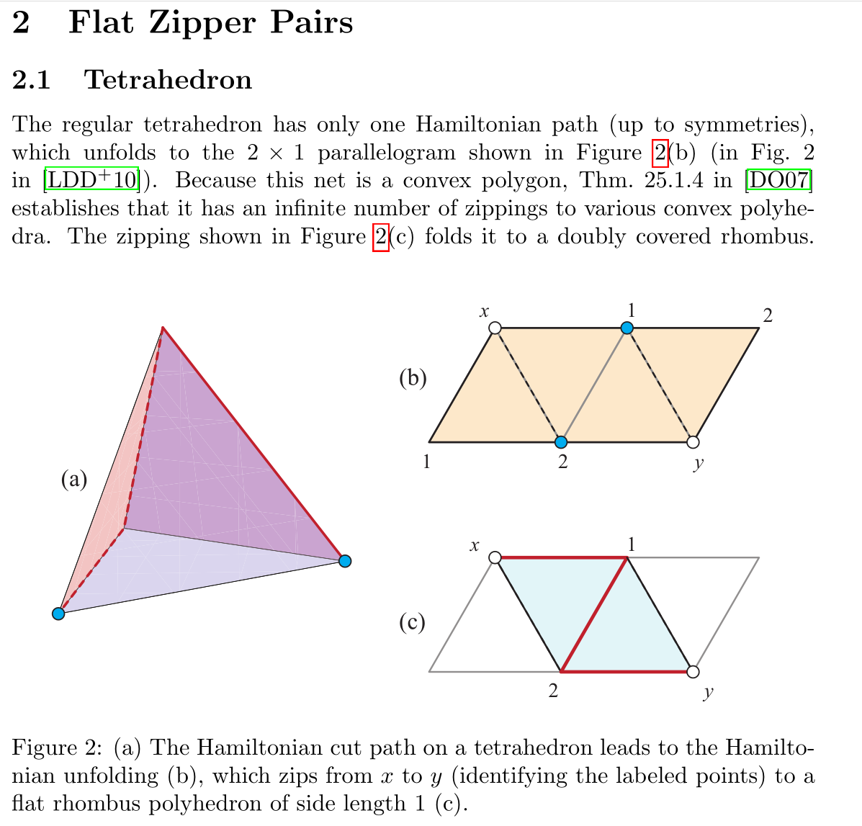
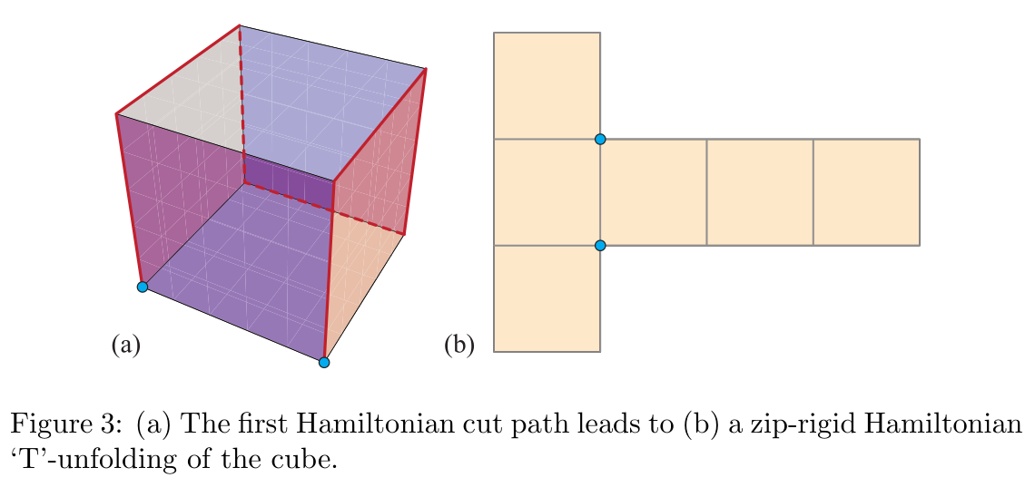
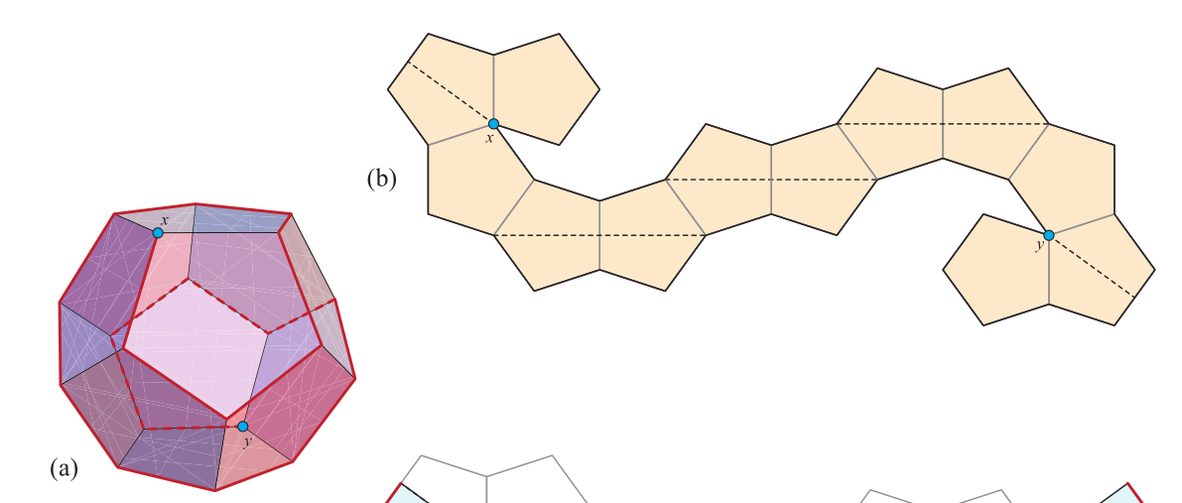
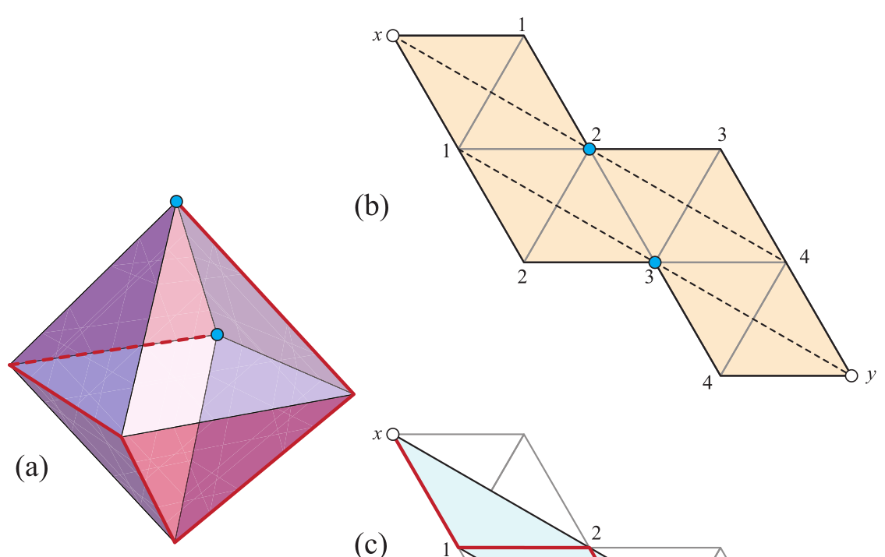
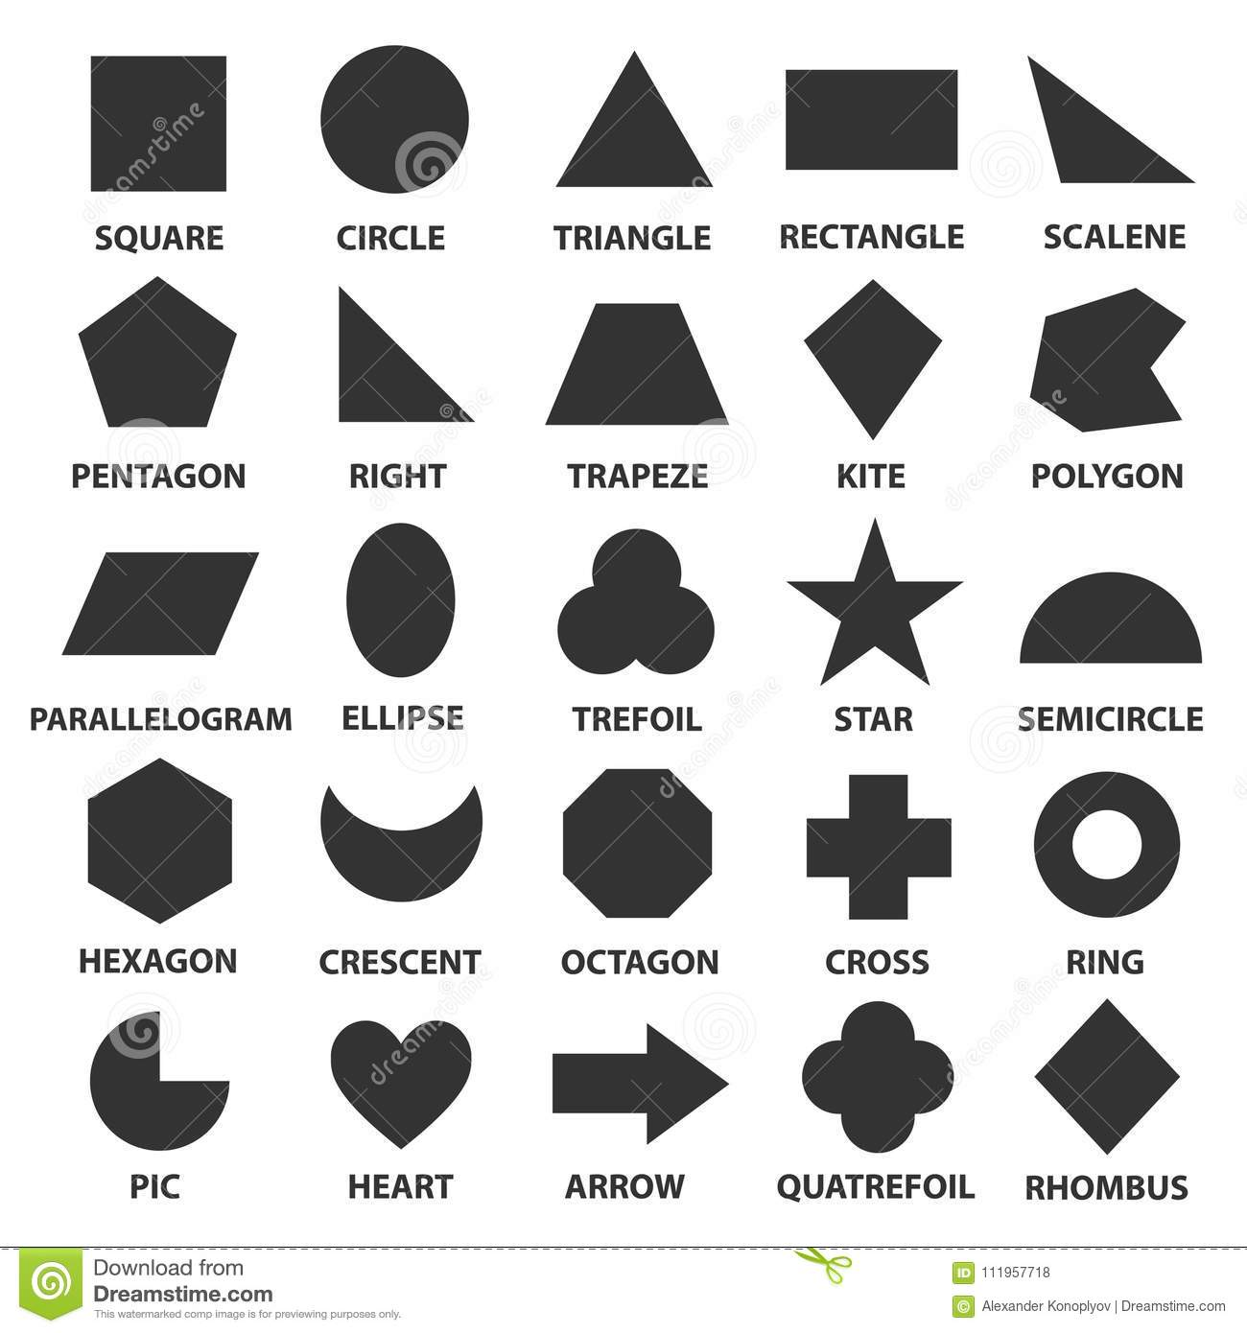
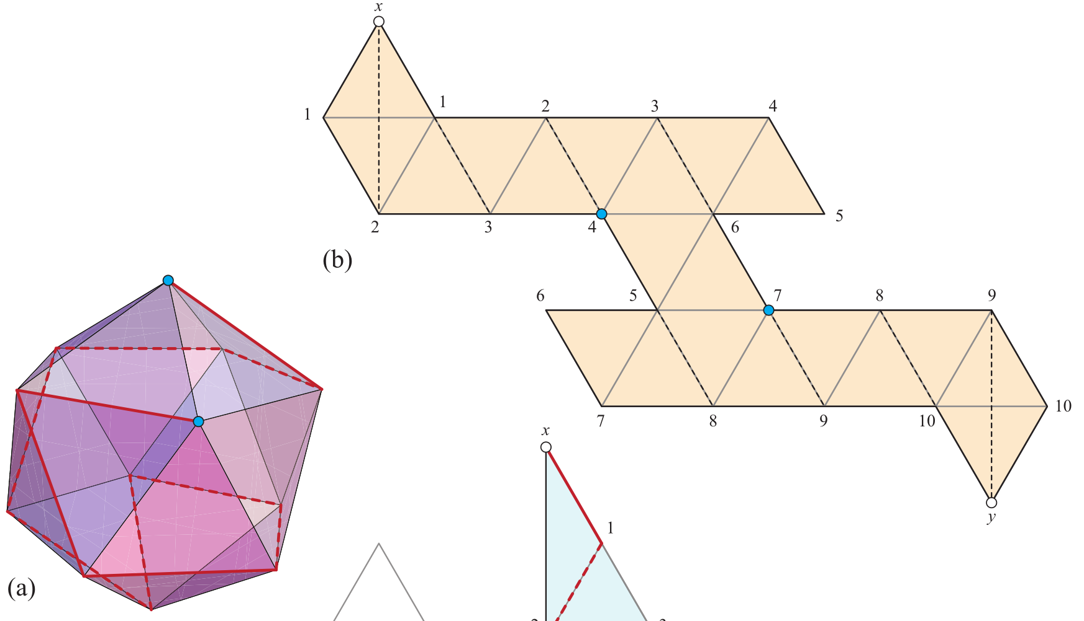
From Paper: 2018 Flat Zipper-Unfolding Pairs for Platonic Solids
Notes:
- Draw different types of unfolding to each types of platonic solids in order to talk about the discretise of surface into triangule or square or pentagon grid

Slide 2
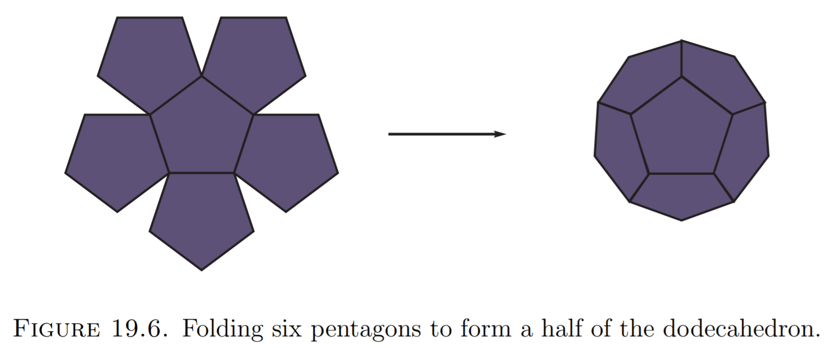
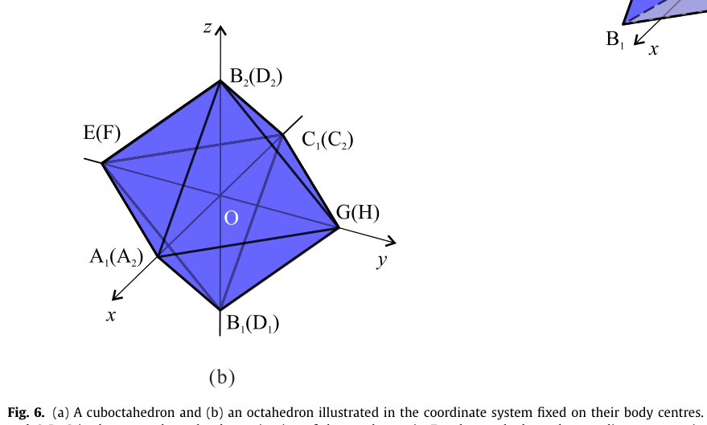
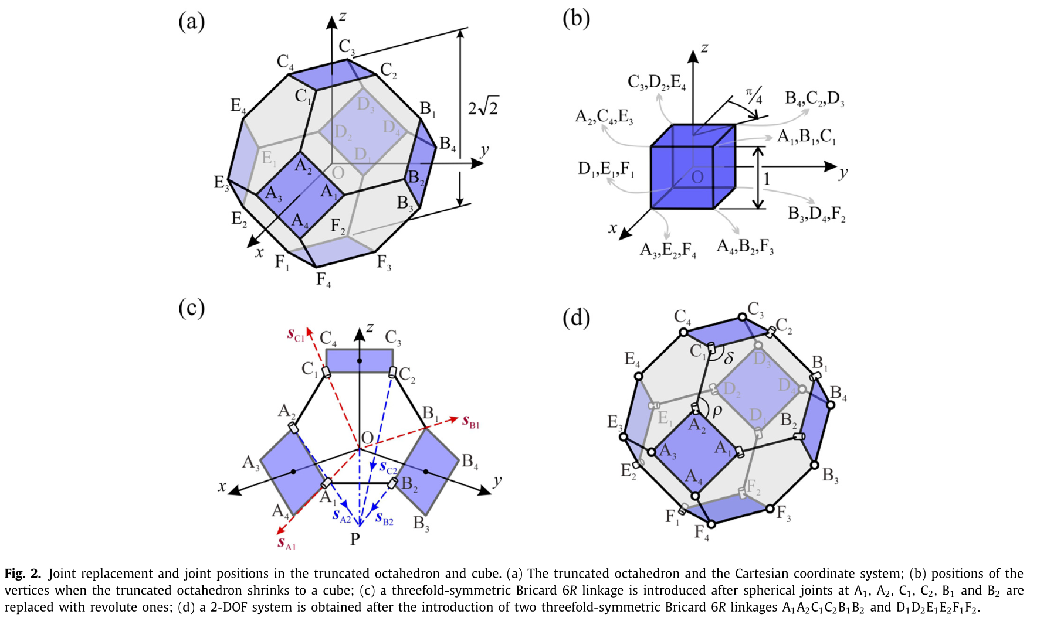
From 2018-2020 Tranformation of polyhedron

Slide 3
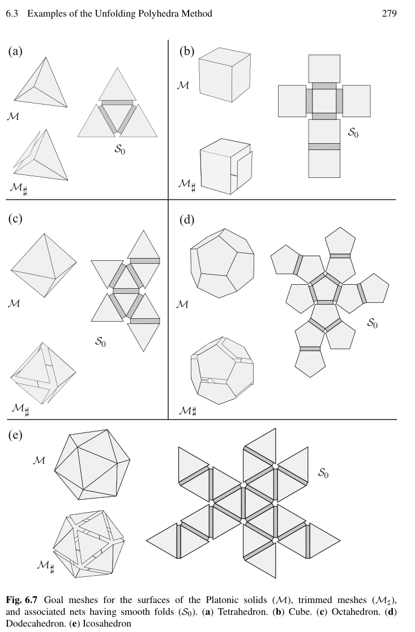
From 2018 perazahernandez- Unfolding Polyhedra Method.pdf

